Slide 1

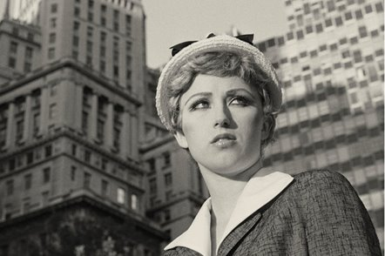
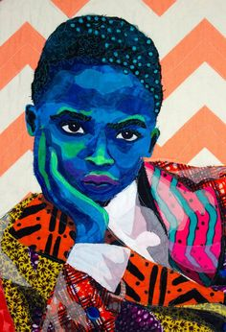
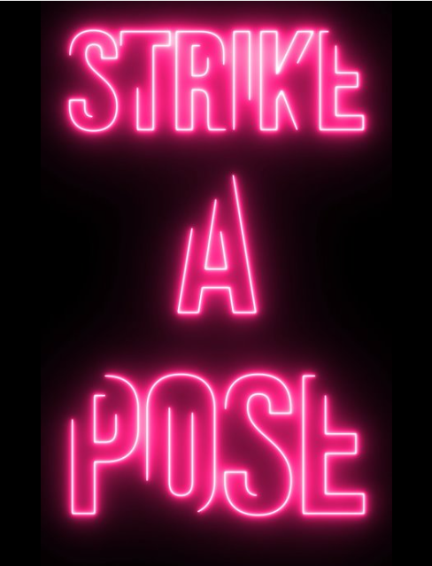
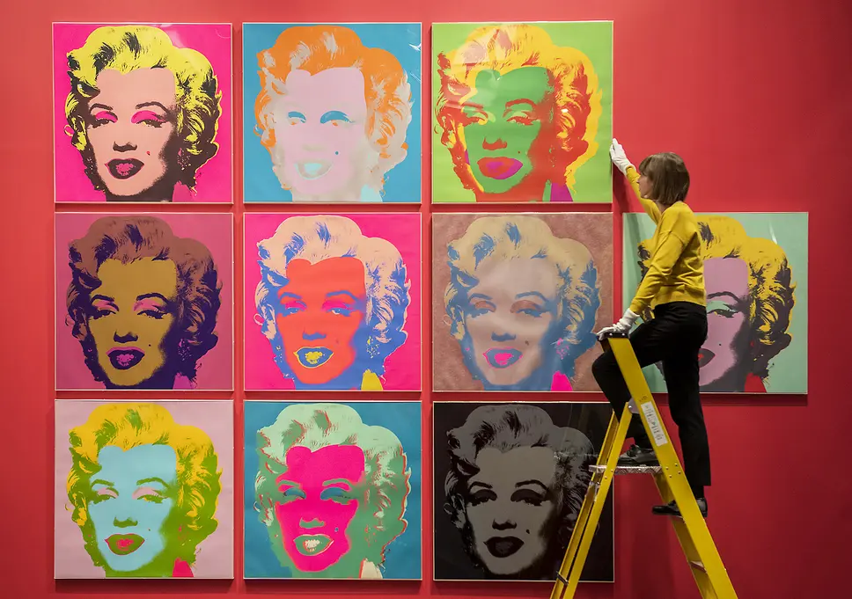
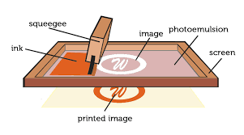
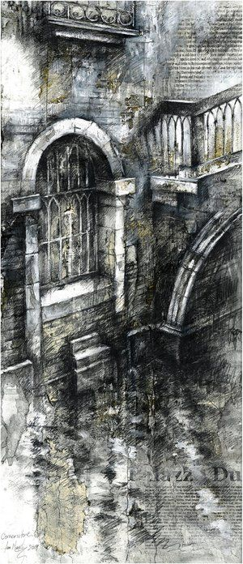
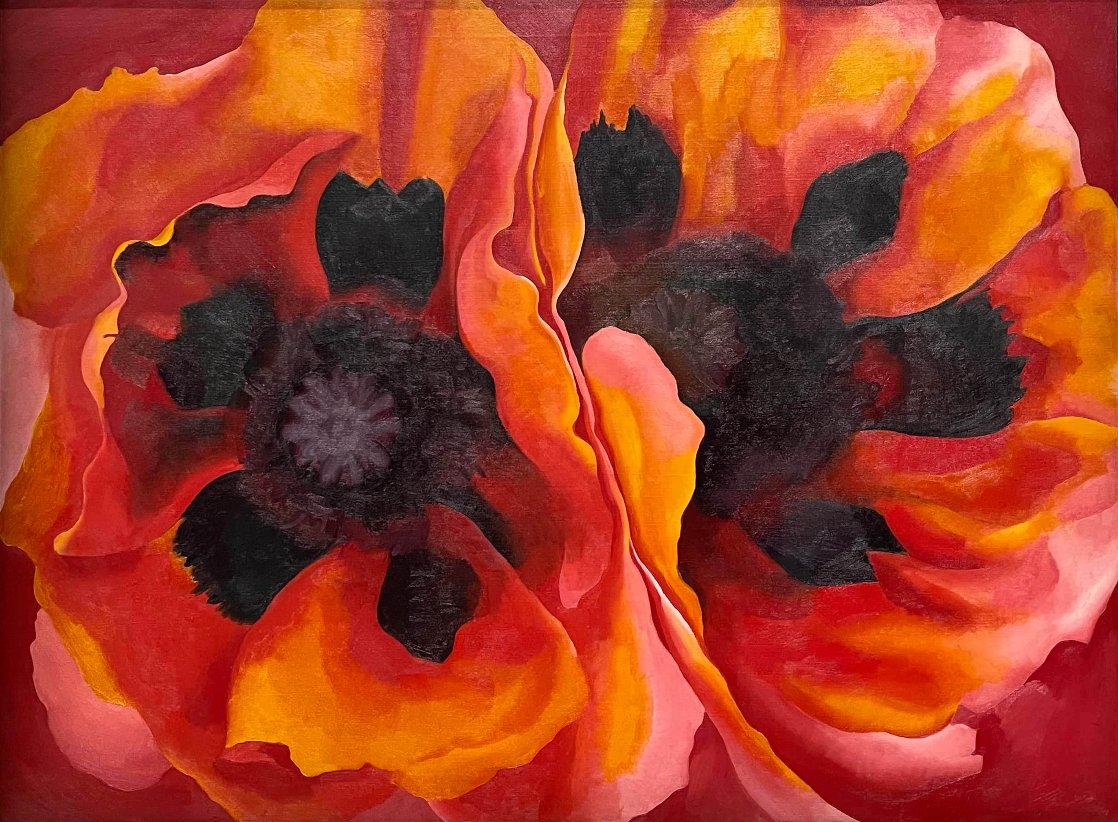
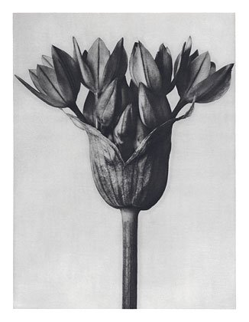
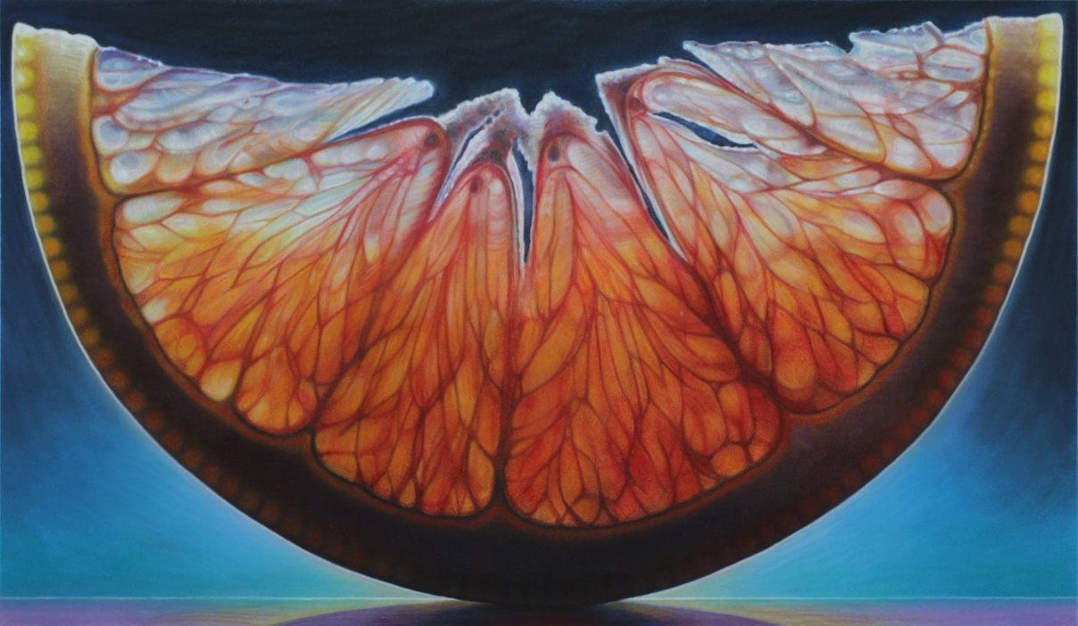
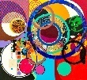
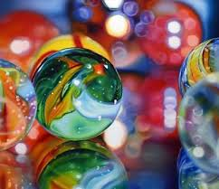
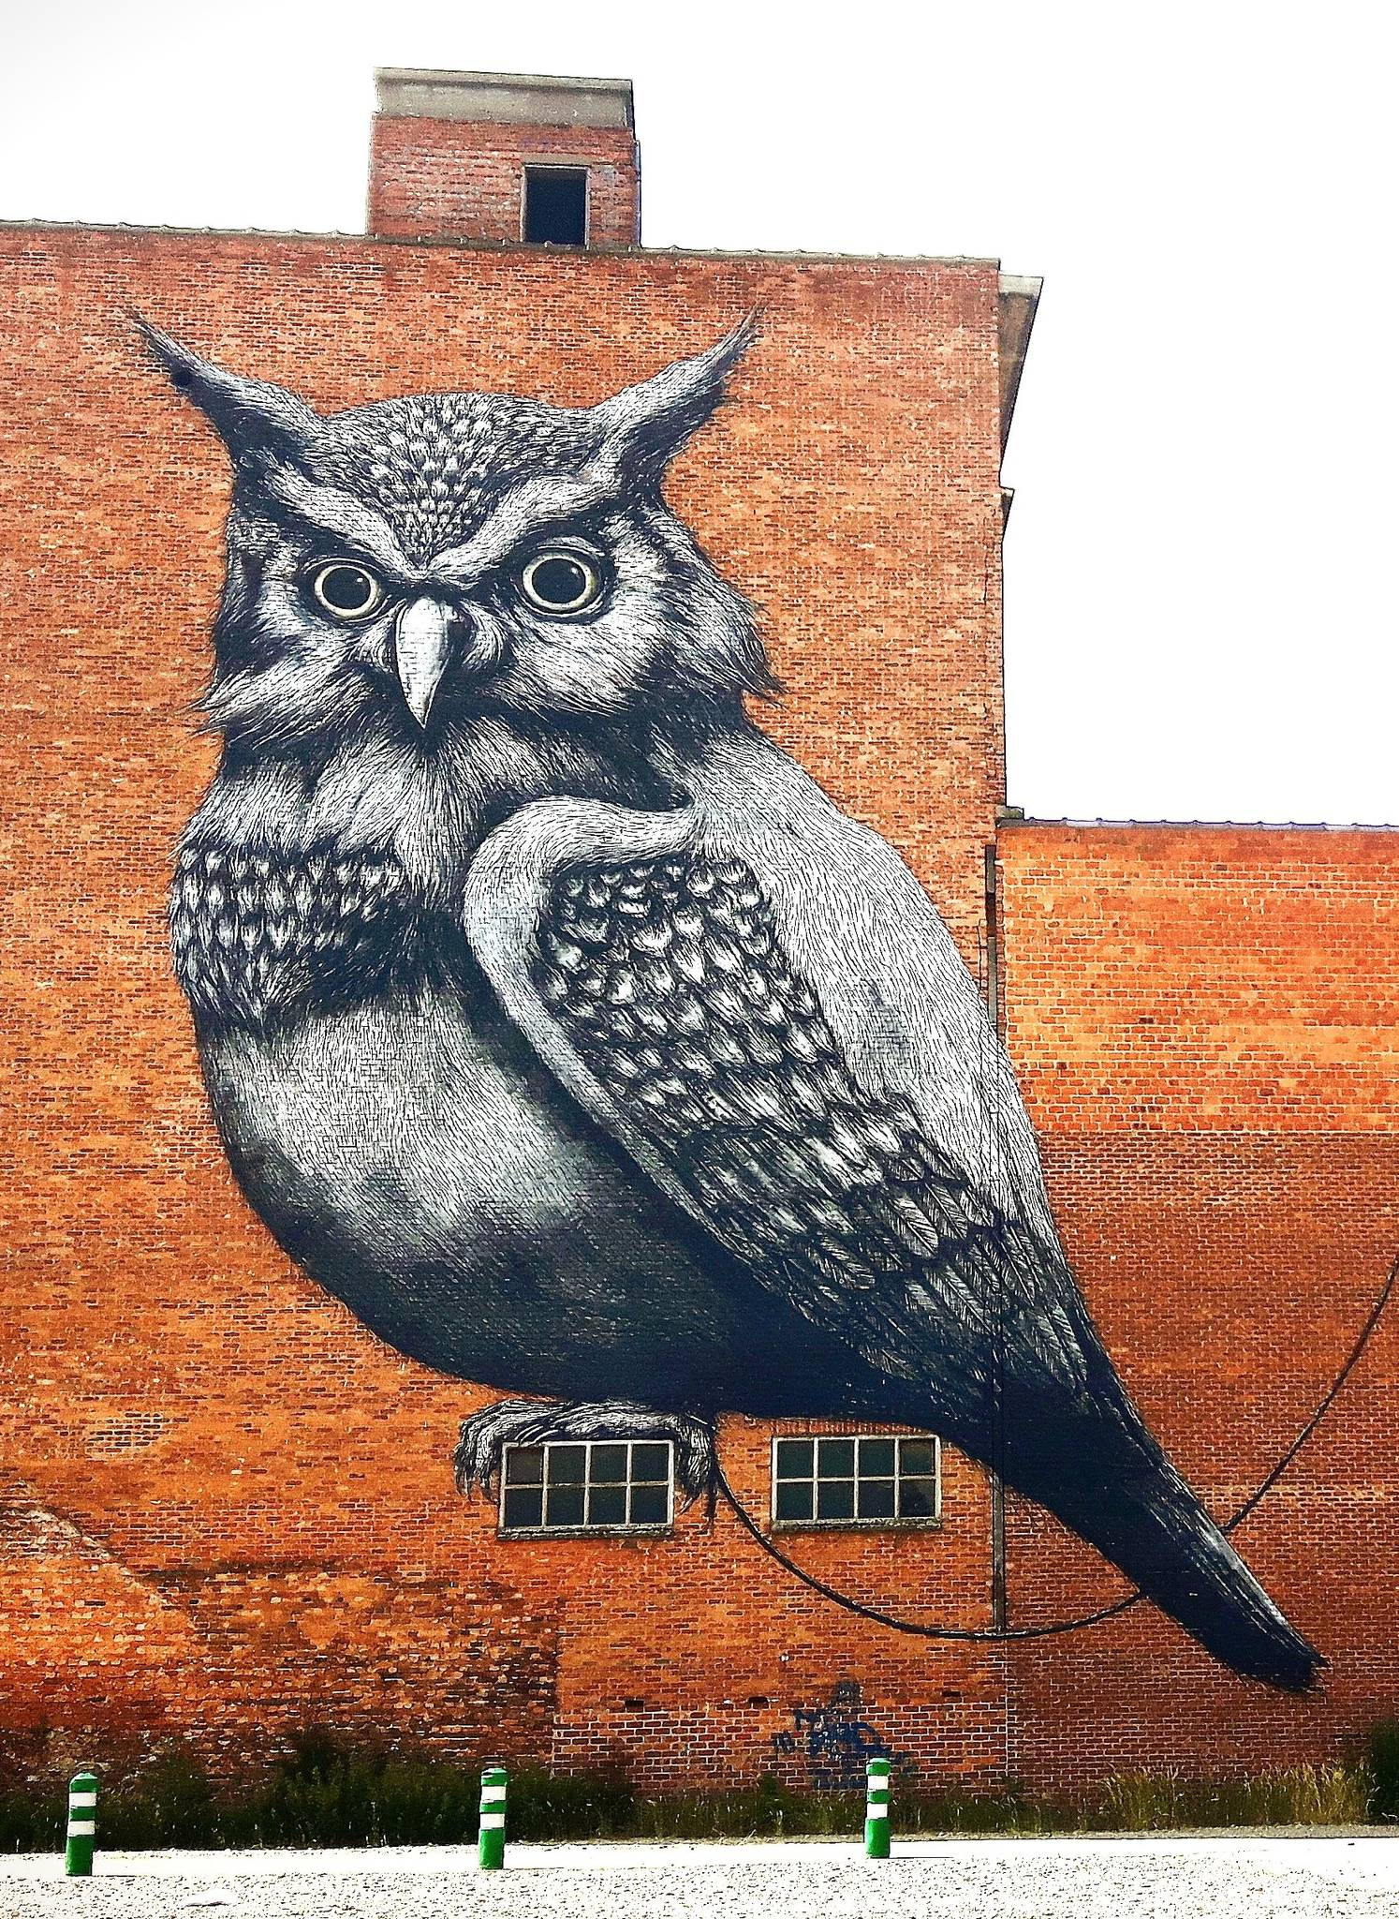
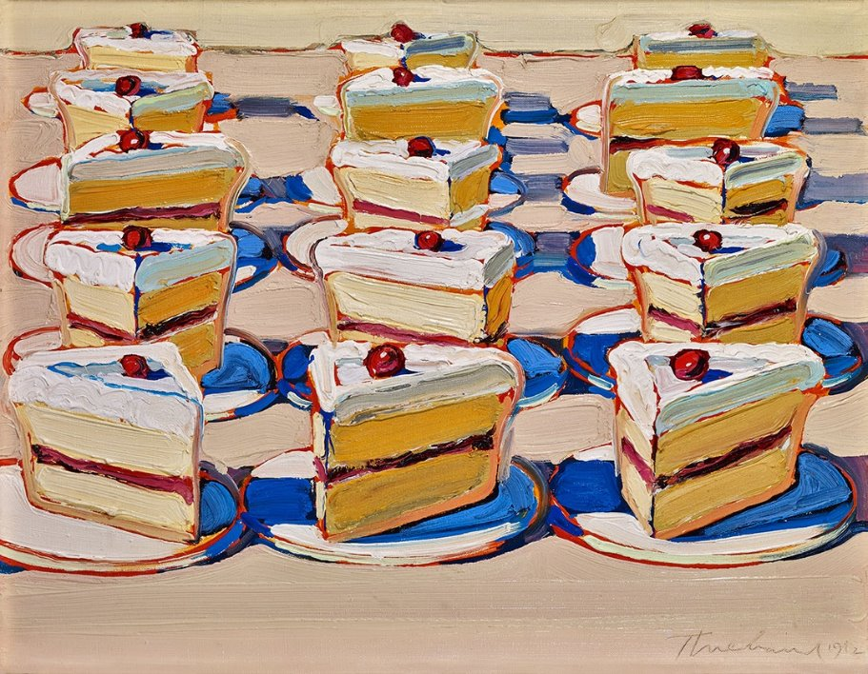

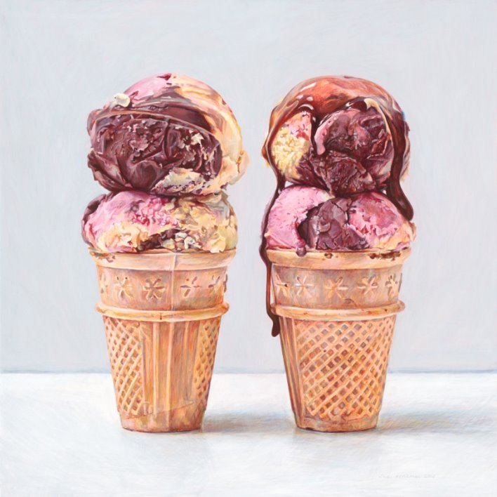
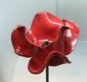
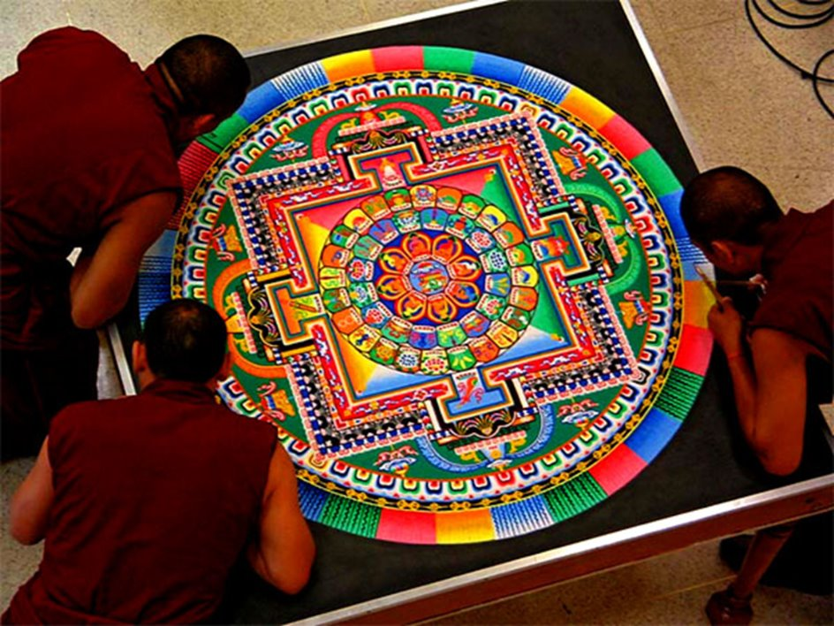
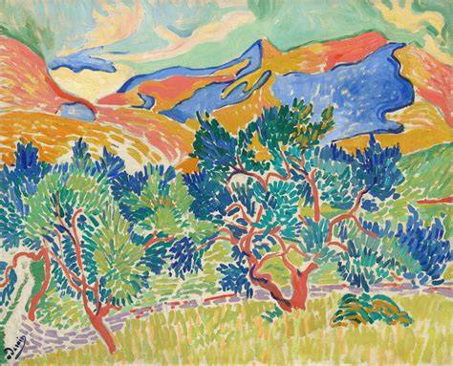
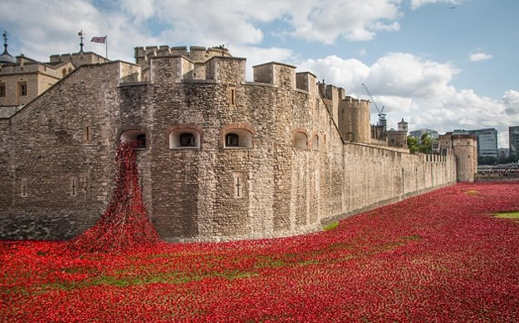


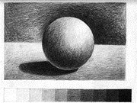
AO3
A returned focus on the formal elements:
Colour, shape, proportions, positive and negative space
ART Department
LEARNING JOURNEY
AO4
Exam: Create a final outcome in response to research and experiments in a 10 hour controlled exam.
AO2 & AO3
Development of ideas through experimentation inspired by research.
AO4
Mock exam: Create a final outcome in response to research and experiments.
AO1
Photo shoot in response to ideas.
AO1
Statement of intent.
Exam paper provided by exam board.
AO2 & AO3
Refinement of ideas: Designing planning and experimenting.
Exam
Return to coursework improvements
AO2 & AO3
Refinement of ideas: Designing planning and experimenting.
AO2 & AO3
Initial ideas: Fast and suggestive drawings.
AO1
Mind map and image collection.
AO2 & AO3
Development of ideas through experimentation inspired by research
AO1
Artist research.
AO2 & AO3
Experimental materials:
Photography, pencil and Acrylic.
AO1
Mind map and planning for independent project to think about over the summer
AO1
Mind map and image collection.
AO1
Artist research.
YEAR
AO2 & AO3
Initial ideas: Fast and suggestive drawings.
11
Strike a Pose:
Independent project
Strike a Pose:
Identity
Strike a Pose:
Independent project
AO1
Artist Reference: Cindy Sherman
AO3
A returned focus on the formal elements: composition, colour, tone, form, scale, proportions and texture.
AO1
Statement of intent.
AO1
Photo shoot in response to ideas.
AO3
A returned focus on the formal elements:
colour, tone, proportions pattern and texture.
AO1
Artist Reference:
Bisa Butler.
AO3
A returned focus on the formal elements:
colour, shape, proportions, positive and negative space.
AO1
Artist Reference:
Andy Warhol.
Strike a Pose:
Celebrity Culture
Strike a Pose:
Black History Month
YEAR
10
AO2 & AO3
Experimental materials: biro, digital art, stencil, silkscreen printing.
AO2 & AO3
Experimental materials: pencil and textiles.
AO3
A returned focus on the formal elements: colour, tone, form scale, proportions and texture.
AO3
A returned focus on the formal elements, form, colour and shape.
AO2 & AO3
Experimental materials: paper surface experiments and collaging.
AO1
Artist Reference
Sarah Graham.
Shapes: Collage
Natural form
Shapes: Marbles
AO1
Artist Reference:
Georgia O’Keeffe, Karl Blossfeldt, Dennis Wojtkiewicz.
AO2 & AO3
Experimental materials: pencil, watercolour, biro, chalk and charcoal, acrylic and oil pastel.
AO2 & AO3
Experimental materials: pencil, watercolour and oil pastel.
AO3
A returned focus on the formal elements: form, colour and shape.
AO1
Artist Reference:
Ian Murphy or Beatriz Milhazes.
YEAR
9
A returned focus on the formal elements: colour, tone, form, scale and proportions.
Understanding the history of Graffiti.
Artist reference: Roa.
Develop acrylic painting skills considering blending and mark making techniques.
Food Glorious Food
Street Art
Artist reference: Sarah Graham, Joel Penkman, Wayne Thiebaud.
Mark making techniques with pen.
Using mixed media to show texture.
Developing an appreciation for others cultural differences.
Using patterns and symmetry with line work and spray paint.
Develop basic building skills in clay.
Reflection of those who have been lost in war.
YEAR
Elements in Art: Pattern and Line
8
Remembrance
Know the difference between visual texture and actual texture.
Fauvist landscapes.
Recognising pattern is integral part of identity in different cultures.
Studying the installation Blood swept lands and seas of red by Paul Cumins and Tom Piper.
Working collaboratively to create an installation.
Practicing control of a paint brush using watercolours.
Know how to use mark making to represent different surfaces and textures.
Using mark making techniques with oil pastels.
Creating a tonal scale.
YEAR
Elements in Art: Colour, Texture and Composition
Elements in Art: Tone, Shape, Scale and Form
7
Understanding the formal elements colour, texture and composition.
Developing shading skills using a pencil.
Understanding the formal elements tone, shape, scale and form.
Understanding the colour wheel and colour mixing skills.
Understanding tints and shades and how to apply them.

