Slide 1




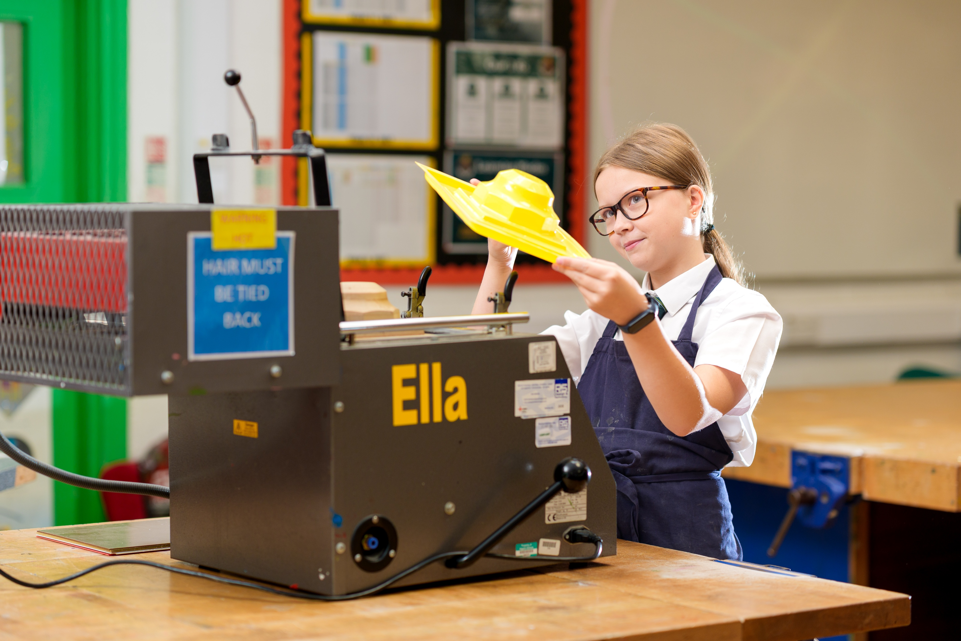
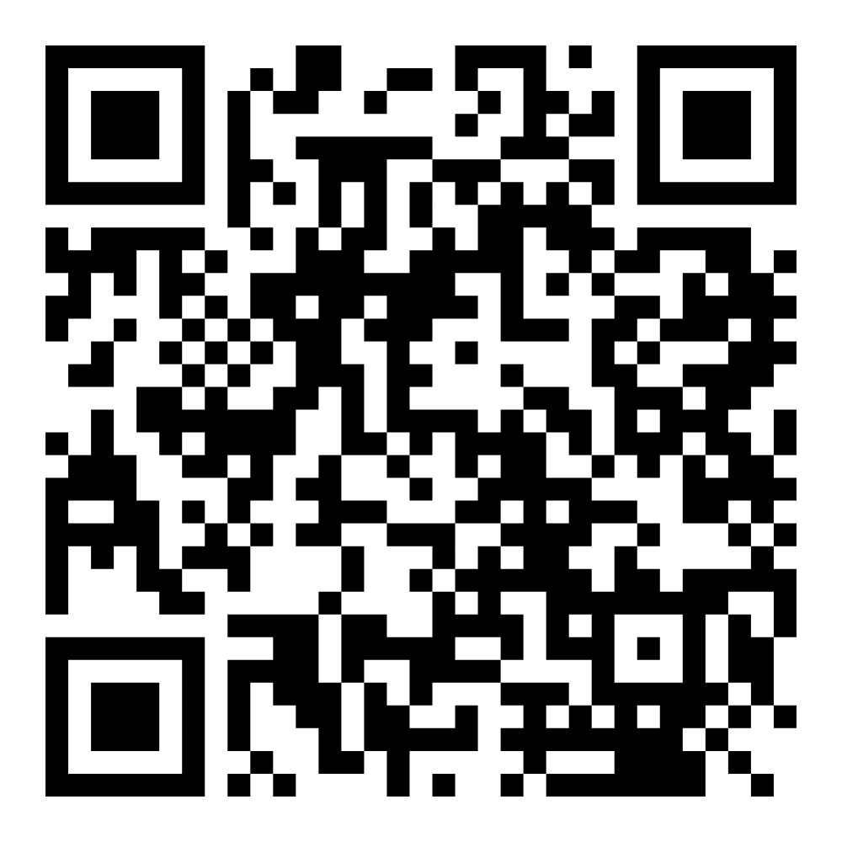

DISC VER
YOUR EGGAR’S
Belong | Aspire | Achieve
Eggar’s School
We invite you to join our exciting Discover Programme for Year 6!
Start your child’s Eggar’s journey with our fun and welcoming discovery workshops. Eggar’s is a small school with a big heart where every child is known and valued. Relationships are strong between staff and students, creating happy a community of great learners, inspired to discover, to explore, and to grow.
SCAN HERE TO BOOK NOW:

Slide 2

YEAR 6 DISC VER YOUR EGGAR’S WORKSHOPS
WELCOME EVENT FOR THE CLASS OF 2031
EGGAR’S EXPERIENCE CLUBS TASTER
TUES 10 MARCH | 5.30PM or 6PM
TUES 17 MARCH | 4PM – 5.15PM
To support your exciting transition to secondary school and to help you feel part of our community right away, join us for this special event where we will be sharing key transition dates and information. There is no need to book.
You will get the chance to visit Pet Therapy, Science Club and Art Club. Visit all three or just stick with your favourite. We’d love to welcome you as you start to Discover what your future at Eggar's will look like.
EGGAR’S EXPERIENCE SPORTS’ CLUBS TASTER
MANAGING CHANGE WELLBEING EVENT
MON 20 APRIL | 4PM – 5.15PM
WED 13 MAY | 6PM
Enjoy a taste of the of sports’ clubs we offer at Eggar's. A variety of drop-in taster activities will be on offer led by our PE department and team members from Soccer Schools.
Join us to consider the many emotions connected to change. There will be a workshop for students led by our ELSA and one for adults led by our Senior Mental Health lead.
All students welcome 15 minutes before the start times.
Scan or visit www.ticketsource.co.uk/eggars-school to book onto our exciting Year 6 workshops.

