Slide 1
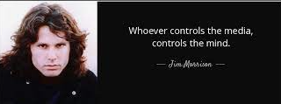




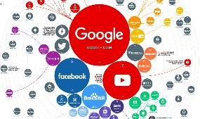






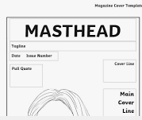











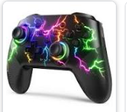



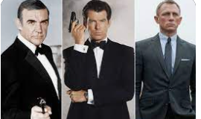


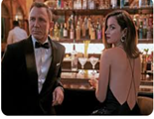



“I declare after all there is no enjoyment like reading! How much sooner one tires of any thing than of a book!
Media Studies Department
LEARNING JOURNEY
Exam technique and structures
Component 1 Section B: Exploring Media Industries and Audiences
Component 1 Section A: Exploring Media Language and representation
Mock exam Component 2
Revision & mastery: Component 1 and 2
GCSE Media Studies
Timed exam Preparation
Component 2: Understanding Media Products
Component 2: Understanding Media Forms
Set product focus and websites
What is Crime drama and why is it so popular?
How has crime drama changed over time?
Gender and ethnicity representations
Revision of the set products
Media language, Representation, Industry and audience
Focus on the set products
Revision for component 1 and 2
Crime Drama
Why do websites and social media appeal to audiences
Analysing examples
Exam techniques
Developing an understanding of target audience
Research and product analysis
Introduction to the assessment brief
Codes and conventions of music videos
YEAR
11
Real Component 3:
Preparation Creating Media
Creating your product
Students write a statement of aims
Planning your product
The Music Industry
The film industry
Uses and gratification theory.
Recap of Bond set products
What is a conglomerate?
Revision of set products
Newspapers, Fortnite, Magazine, The Archers and Adverts
Active audiences
Recap of Bond
Revision of Component 1
Website analysis
Regulation of the film industry
Exam techniques, tips and hints.
Component 1 Exam and feedback
Introduction to the history of music videos
Regulation of the Industry
Who listens to the DID?
Uses and Gratifications
The newspaper industry
Analysing contemporary advertising vs historical advertisements
Dress Codes
The BBC
Desert Island Discs
Newspapers
Advertising
Technological advances
Conventions of Broadsheets and tabloid newspapers
Analysis of front-page conventions
Production processes
YEAR
Representation of gender and ethnicity
Comparison Essay structure
10
What is the appeal of Fortnite?
TV Scheduling
Theoretical perspectives on representation
Create a pitch and write a statement of aims.
Television
Magazines
Introduction to Magazines and Creating Media
Codes and conventions of magazine covers
Regulation of the gaming industry
Changes in viewing habits
Introduction to set products
Analysing semiotics of magazine covers
Responding to a brief students will create a short film, considering, camera angles, setting, lighting and mise-en- scene
Uses and Gratifications Theory introduction
Video Games
Design a new computer game
How sound and editing can communicate meaning.
Analysing a Bond Film
The history of the Bond Movies
Propp’s Theory of narrative
YEAR
Exploring representation in video games
Bond Industry and marketing
What is Media?
9
Stereotypes and their representation
Genre conventions of films
Film marketing
Marketing of A Bond Movie
What is media language

