Slide 1
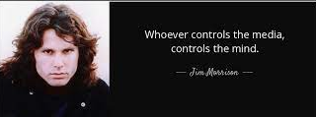











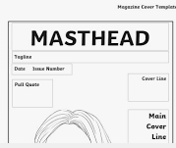





















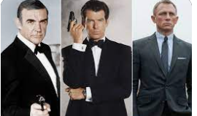
“I declare after all there is no enjoyment like reading! How much sooner one tires of any thing than of a book!
Media Studies Department
LEARNING JOURNEY
Exam technique and structures
Component 1 Section B: Exploring Media Industries and Audiences
Component 1 Section A: Exploring Media Language and representation
Mock exam Component 2
How has crime drama changed over time?
Revision & mastery: Component 1 and 2
GCSE Media Studies
Timed exam Preparation
Component 2: Understanding Media Products
Component 2: Understanding Media Forms
Introduction to the history of music videos
Gender and ethnicity representations
Introduction to the set products
Media language, Representation, Industry and audience
Crime Drama
Music Videos and the Star Persona
What is Crime drama and why is it so popular?
Fandom
Analysing examples
Codes and conventions of music videos
The Music industry
Exam techniques
Regulation of the Industry
Active audiences
Developing an understanding of target audience
Features of a double page spread
Introduction to the assessment brief
YEAR
Who listens to the Archers?
YEAR
Real Component 3: Creating Media
11
Ownerships and the main music industry
Planning your product
Research and product analysis
Students write a statement of aims
Technological advances
Uses and gratification theory.
Newspapers, Fortnite, Magazine and Adverts
The Archers
What is a conglomerate?
Revision of set products
Soap opera genre
Revision of Component 1
The BBC
Marketing of A Bond Movie
Technological advances in film
Regulation of the film industry
Exam techniques, tips and hints.
Component 1 Exam and feedback
Overview of the radio industry
Bond Industry
Website analysis
Introduction to Bond set products
Analysing contemporary advertising vs historical advertisements
Representation of gender and ethnicity
Analysing semiotics of magazine covers
Advertising
Magazines
Codes and conventions of magazine covers
The film industry
Dress Codes
Theoretical perspectives on representation
Introduction to set products
Comparison Essay structure
YEAR
Production processes
10
Conventions of Broadsheets and tabloid newspapers
Film marketing
Create a pitch and write a statement of aims.
What is the appeal of Fortnite?
Newspapers
Creating Media
Regulation of the gaming industry
Analysis of front-page conventions
The newspaper industry
Responding to a brief students will create a short film, considering, camera angles, setting, lighting and mise-en- scene
Video Games
Uses and Gratifications Theory introduction
Design a new computer game
Types of narrative
Introduction to media language
Analysing a Bond Film
How sound and editing can communicate meaning.
Propp’s Theory of narrative
YEAR
Exploring representation in video games
Bond Films
What is Media?
9
Stereotypes and their representation
The history of the Bond Movies
Genre conventions of films
What is media language

