Slide 1
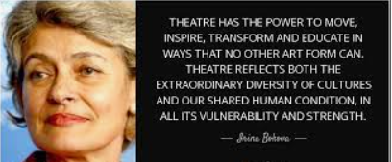

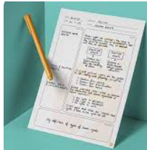

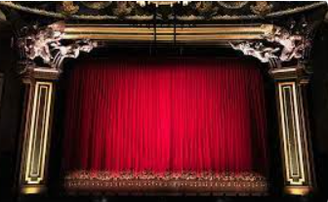
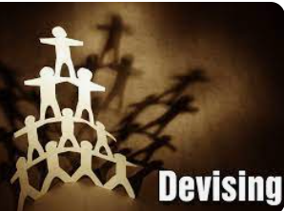

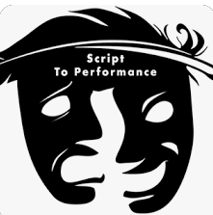
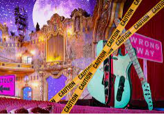


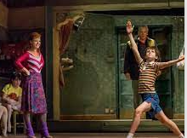


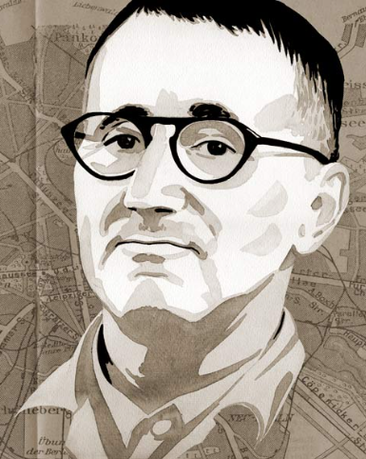

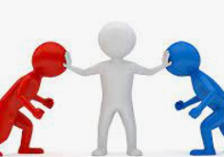
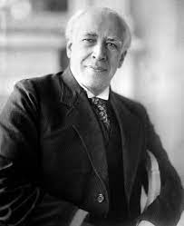


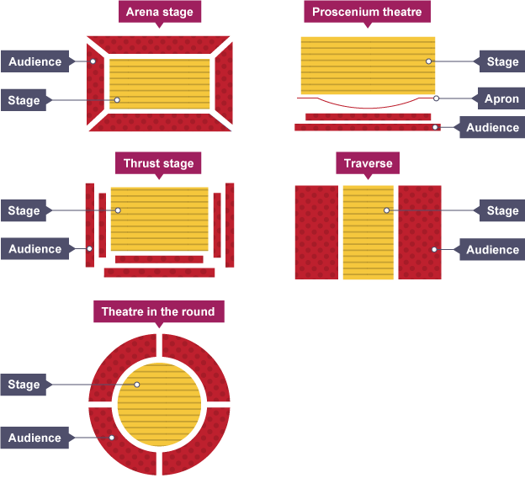
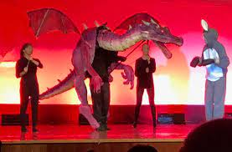

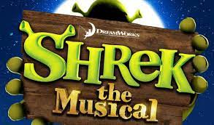
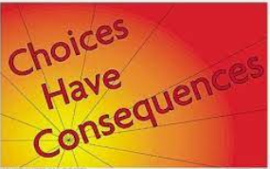
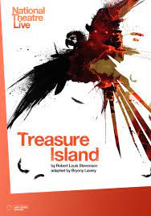
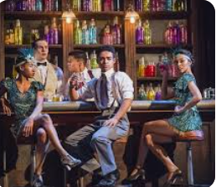

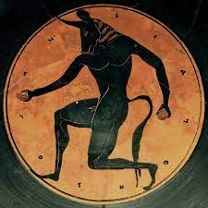
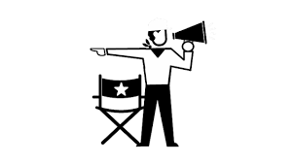

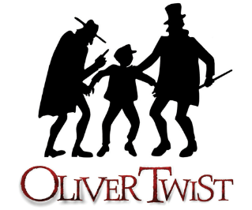
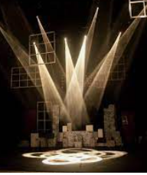

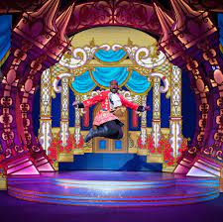
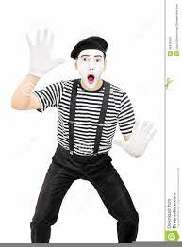
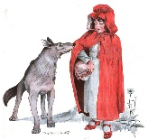

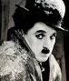
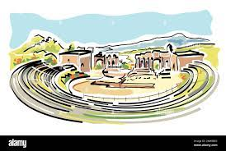
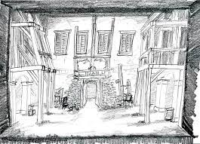
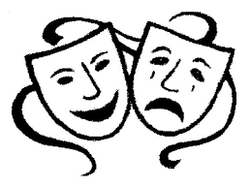
Describe, analyse and evaluate am actors portrayal.
Drama Department
LEARNING JOURNEY
Performance of two scripted extracts from the same play in front of AQA examiner
Reading a play and studying historical, social and cultural context
GCSE Drama written exam final preparation
GCSE Drama qualification and love of theatre!
Revision & mastery: Component
1
Revision and exemplar exam questions
Timed practices
Rehearsal and mastery of acting skills
Completion of Log 2 - Development and Collaboration
Completion of Log 3 – Analysis and Evaluation
Section A recall activities
Rewatching Billy Elliot to ensure notes are clear and detailed.
Real Component 3
Developing an understanding of the expectations for component 2
YEAR
Real Devising Component 2
11
Revision of Component 1
Structures and timing for section B
Focus on character interpretation and portrayal
Exploring a range of innovative techniques ways to explore meaning.
Response to Stimulus Log 1
Students devise and perform a piece of theatre based on the theme of Missing
Devising Skills
Revision of structures and expectations for section B of the written exam.
Understanding of the historical, social and cultural context.
Describe, analyse and evaluate an actor’s portrayal.
Realisation of artistic aims and communication of meaning.
YEAR
How successful theatre companies communicate meaning through staging, acting skills and innovative practice
Blood Brother revision
and Text in Practice Mock
Live Theatre Review
10
Component 3 – Text in Practice revision
Focus on key moments
Plot summary
Introduction to the Frantic Method and Physical theatre methods
Interpreting, rehearsing and performing a monologue and group piece
Component 3 – Text in Practice Introduction
Component 1 – Introduction to Section C of the written exam. Describe, analyse and evaluate an actor’s portrayal.
Component 1 Section B
Introduction to Component 2 Performance and Logs
Devising
Stanislavski method
Script Sampler
The Railway Children
Blood Brothers
Acting skills terminology
Play Script reading
Component 1 – Section A
Exploration of the play, themes and characters and introduction to the questions in Section B
YEAR
9
Adapting the style of theatre to meet the needs of a target audience
Understanding the power of theatre to educate and introduction to basic Brechtian techniques
Puppeteer’s Role
Using a range of acting skill to perform a realistic character
Shrek the Musical
Mathew Come Home
Theatre in Education
Devising Skills
Integrating design elements
How a theatrical show needs to be commercially successful
Exploring basic Stanislavski’s rehearsal techniques
What constitutes effective TIE?
Watch, analyse and evaluate an actor’s performance in Treasure Island
Script skills, including line learning to perform a scene from The Godmother
Developing acting skills to convey tension
Exploration of the conventions of Murder Mystery genre
Murder
Mystery
Exploration of the stock characters and stage conventions for Melodrama, to create a class performance of ‘Foiled Again’
Accent work
Accent work
Appreciation of Live Theatre
YEAR
Live
Theatre Review
The Godmother
8
Oliver
Production Study
Melodrama
Introduction to Ensemble technique
Director’s Role
Write a Live theatre Review
Project Style Homework – Shoe box theatre set design
Lighting designer’s Role and how lighting can enhance mood and atmosphere
How is a theatrical production is realised.
Choral speaking techniques
Costume Designer’s Role
Appreciation of live theatre
Greek theatre
What makes a good performance. Developing audience awareness
Exploration of Greek Myths
YEAR
Using knowledge and skills of choral work to perform a version of a Greek myth.
Pantomime and vocal skills
Silent Movie and Mime
7
Set designer’s Role
Using knowledge of conventions for pantomime, and vocal and physical acting skills to create your own Pantomime.
Using knowledge of the conventions of Silent Movies – captions, chase and stage fighting, plus a focus on physical acting skills to create your own silent movie
Basic rules of Mime – a focus on physical acting skills
The origins of theatre

